Slide 1
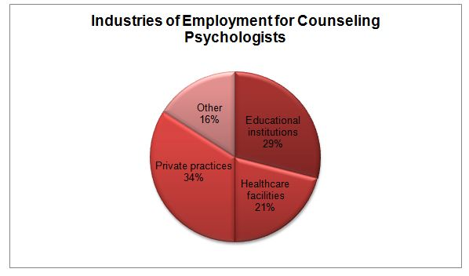
My Career Exploration
Allison Smith
Tech Apps

Slide 2
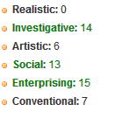
Naviance
■ I began my research by visiting a website called Naviance and taking a Personality Type Survey and an Interest Inventory Survey.
■ I have displayed some of my results to the right.
My strongest interests are in green and mean the following:
■ Investigative: Require an extensive amount of thinking.
■ Social: Involve working with, communicating with, and teaching people.
■ Enterprising: Frequently involve starting up and carrying out projects.

Slide 3
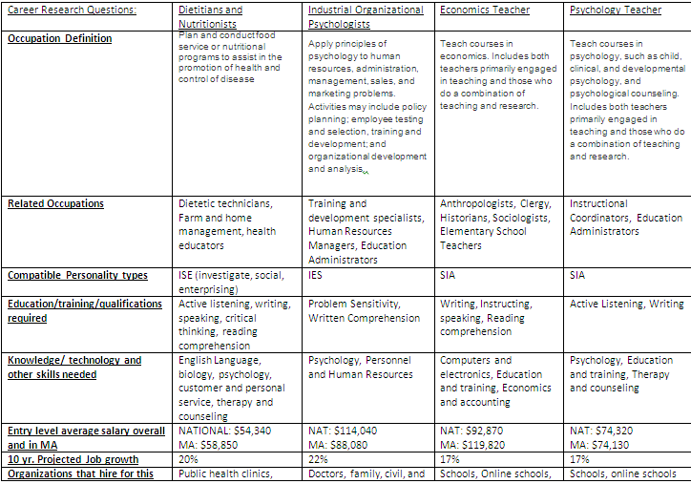
Career Research
■ Following taking the surveys, I picked from a long list if careers that matched the results of my surveys and chose those to do my research on.
■ I picked 8 to research further and organized them into a graph and searched information such as Qualifications, organizations that hire for that career, and advancement opportunities.

Slide 4
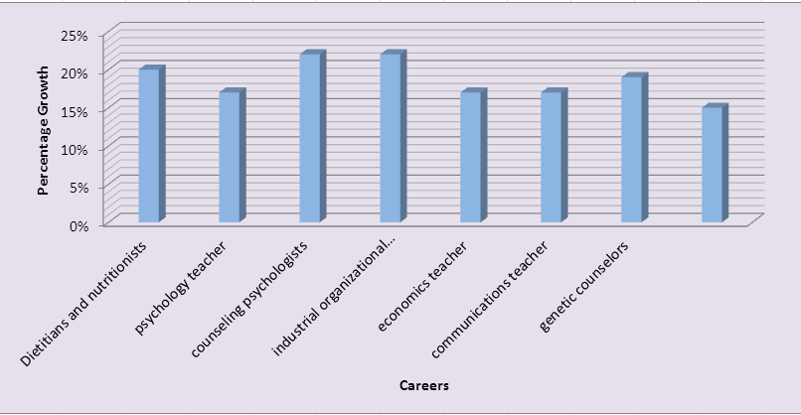
Graphs
■ After I researched all 8 of my careers I organized their projected job growths and such into a graph on Microsoft Excel.
■ This gives me a better idea of what career has the highest job growth and which has the lowest.
■ I made 3 graphs/ charts in all out of the following: average salary, projected job growth, and number of years of education required for each job.

Slide 5
Concluding my research I listed the pros and cons of my chosen careers which really helped me get a better idea of what each one is like.
I ranked my jobs and narrowed it down to my top 3 to describe why I thought those fit me best out of the 8 careers I began my research with.

Slide 6
My top 3 career choices were as follows in order: Counseling Psychologists, Dietitians and Nutritionists, and Psychology Teacher
Counseling Psychologist: I chose this as my first choice because they work in a variety of settings to provide people things such as psychotherapy like hospitals, mental health clinics, or often with mental health physicians like social workers and nurses. They tend to not only focus on psychotherapy but also maintaining a healthy life span. However, the job may also be stressful at times, which might have you work long or odd hours in the day.
For my second choice, Dietitians and Nutritionists. Dietitians and Nutritionists require certain skills but these skills aren’t necessarily learned through formal training either. However, depending on what environment you’re working in, the job gives you a lot of flexibility.
Psychology Teacher: For my last choice, teaching psychology would be interesting at the very least because you’re making a difference to the children you’re teaching as well as talking about and educating your students about something you are passionate about.

